Slide 1
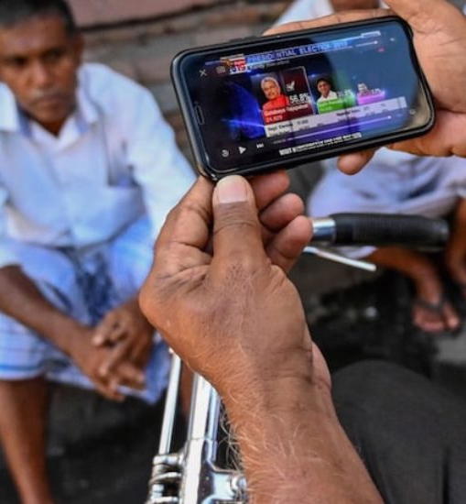
DATA-DRIVEN JOURNALISM
Data-Driven Generation of Visualizations for Automatically Generated News Articles
2023-24-043

Slide 2
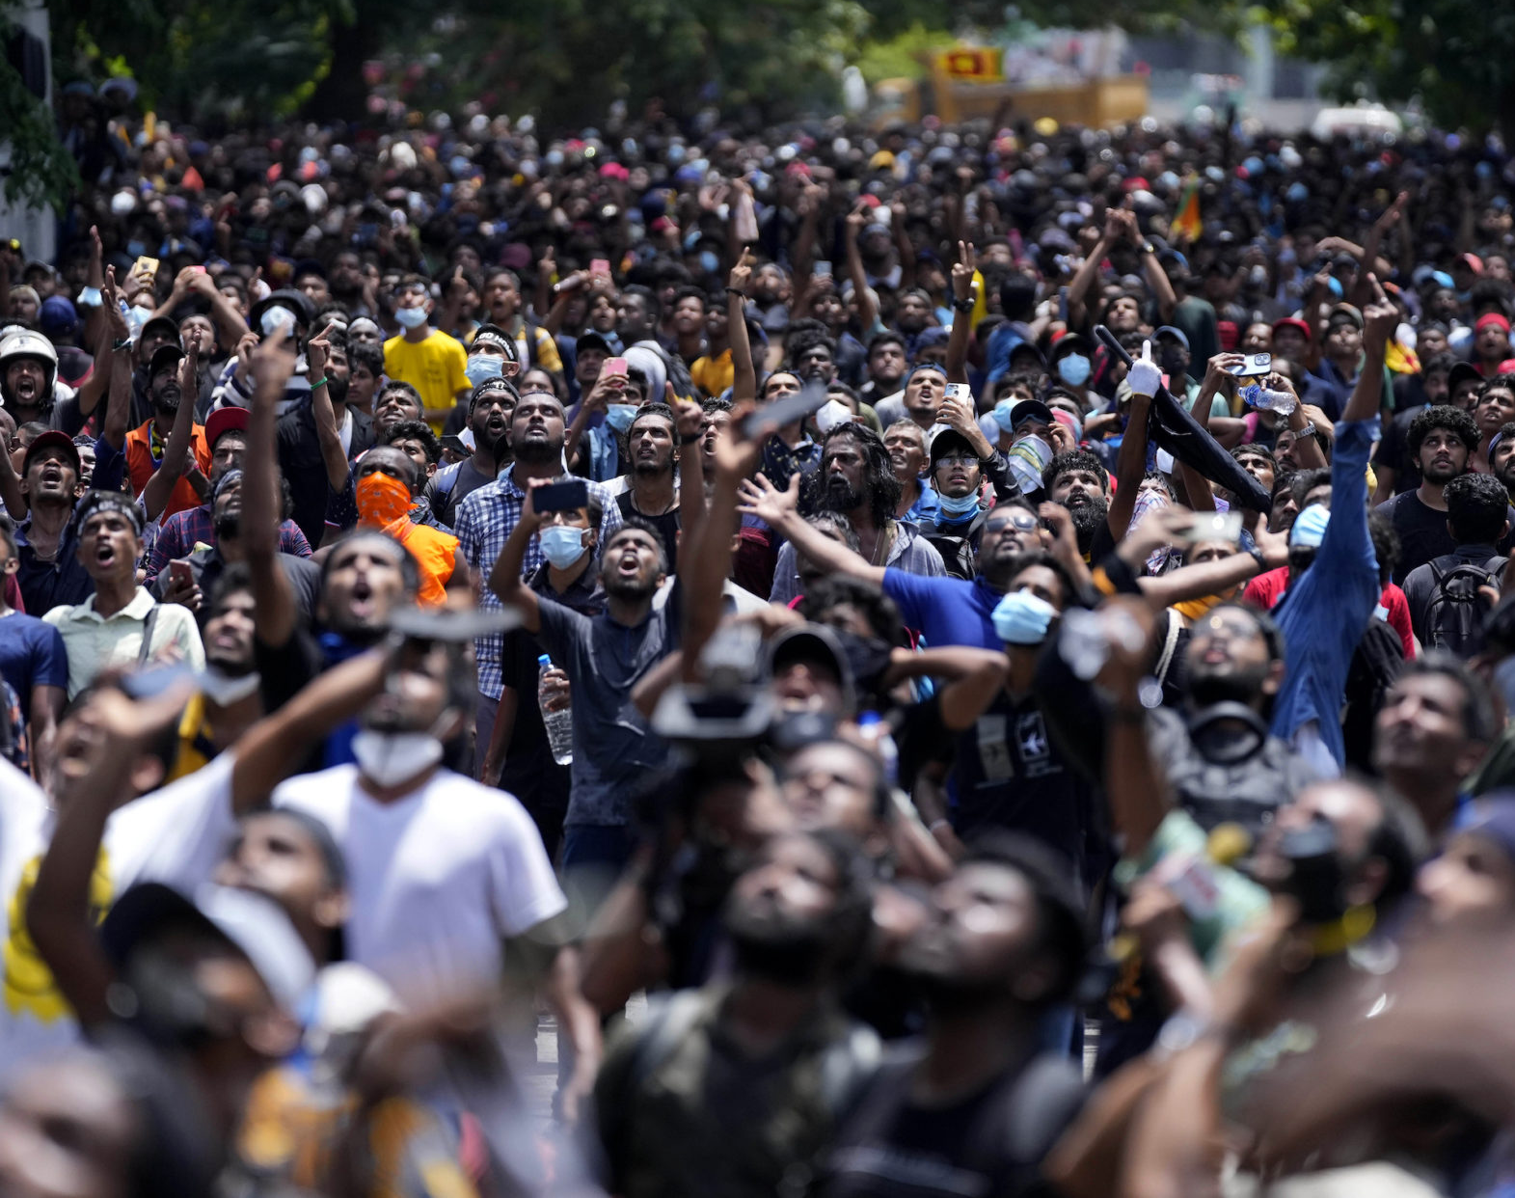
We are on a mission to develop and ensure responsive, inclusive, participatory, and representative decision-making at all levels.

Slide 3
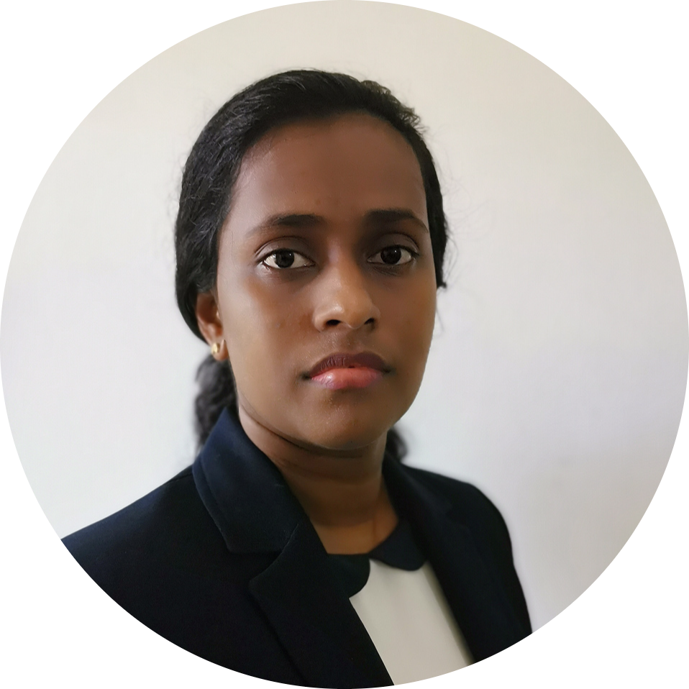
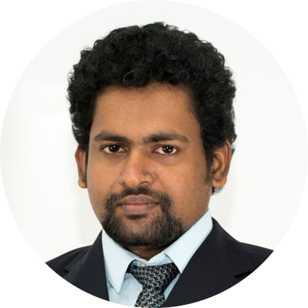




The Team That Makes It Happen
Dr. Kalpani Manathunga
Supervisor
Dr. Dharshana Kasthurirathna
Co-Supervisor
Nimila Jayawardhana
Group Leader
Ravindu Jayathilaka
Member 01
Malith Lakshan
Member 02
Kumara S.K
Member 03

Slide 4
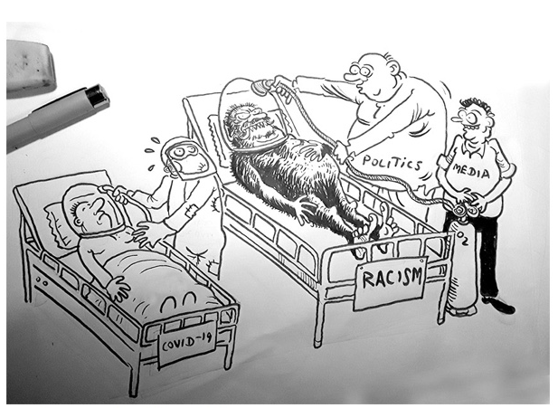
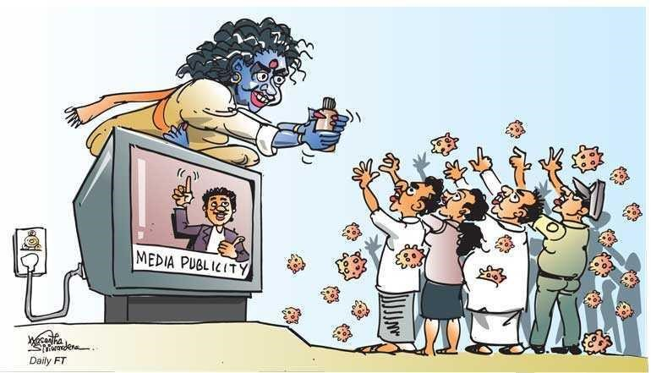
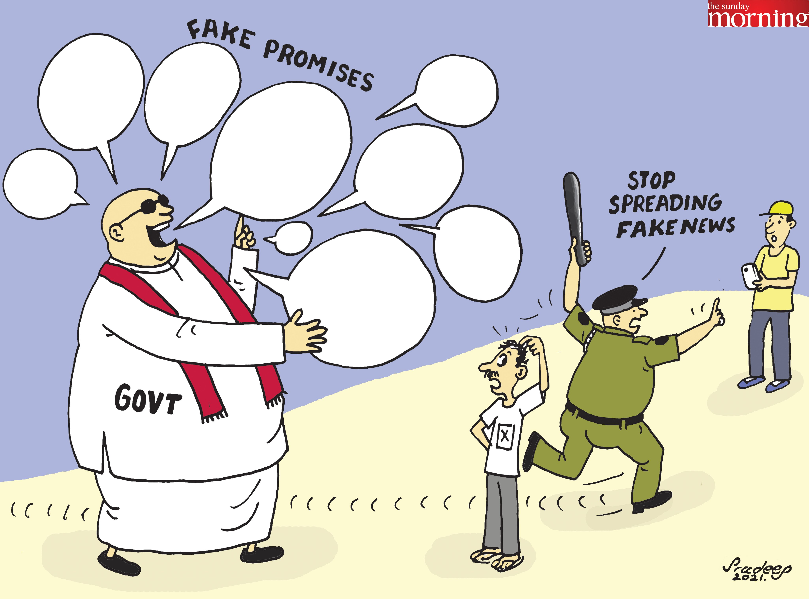
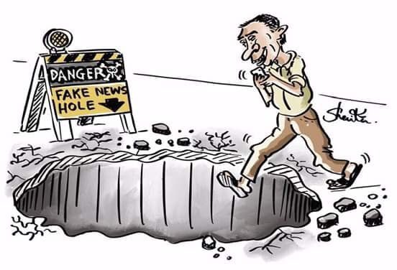
Research Problem
Sri Lankan people make their decisions based on gut feelings rather than being information-driven.[1]
For example, this is evident in decision-making patterns during elections, where politicians may leverage sensitive institutional points, such as religious beliefs, misinformation, racism, and unrealistic promises, to sway voters' choices.

Slide 5

How We Align with SDG Goals?
By promoting open access to data and knowledge, we contribute to the UN's vision of a more sustainable and equitable world by 2030.

Slide 6
The reasons why Sri Lankan people make their decisions based on gut feelings?
The availability of information
Psychological Factors
Limited Time and Cognitive Effort
Impact of Misinformation
Tradition and Social Norms

Slide 7

How do we plan to address this?
To build a user-friendly data-driven news web platform that acts as a reliable and trustworthy bridge between data, journalism, and the general public.
We aim to empower individuals with the tools and knowledge to make informed decisions, fostering a society that embraces data-driven thinking.

Slide 8
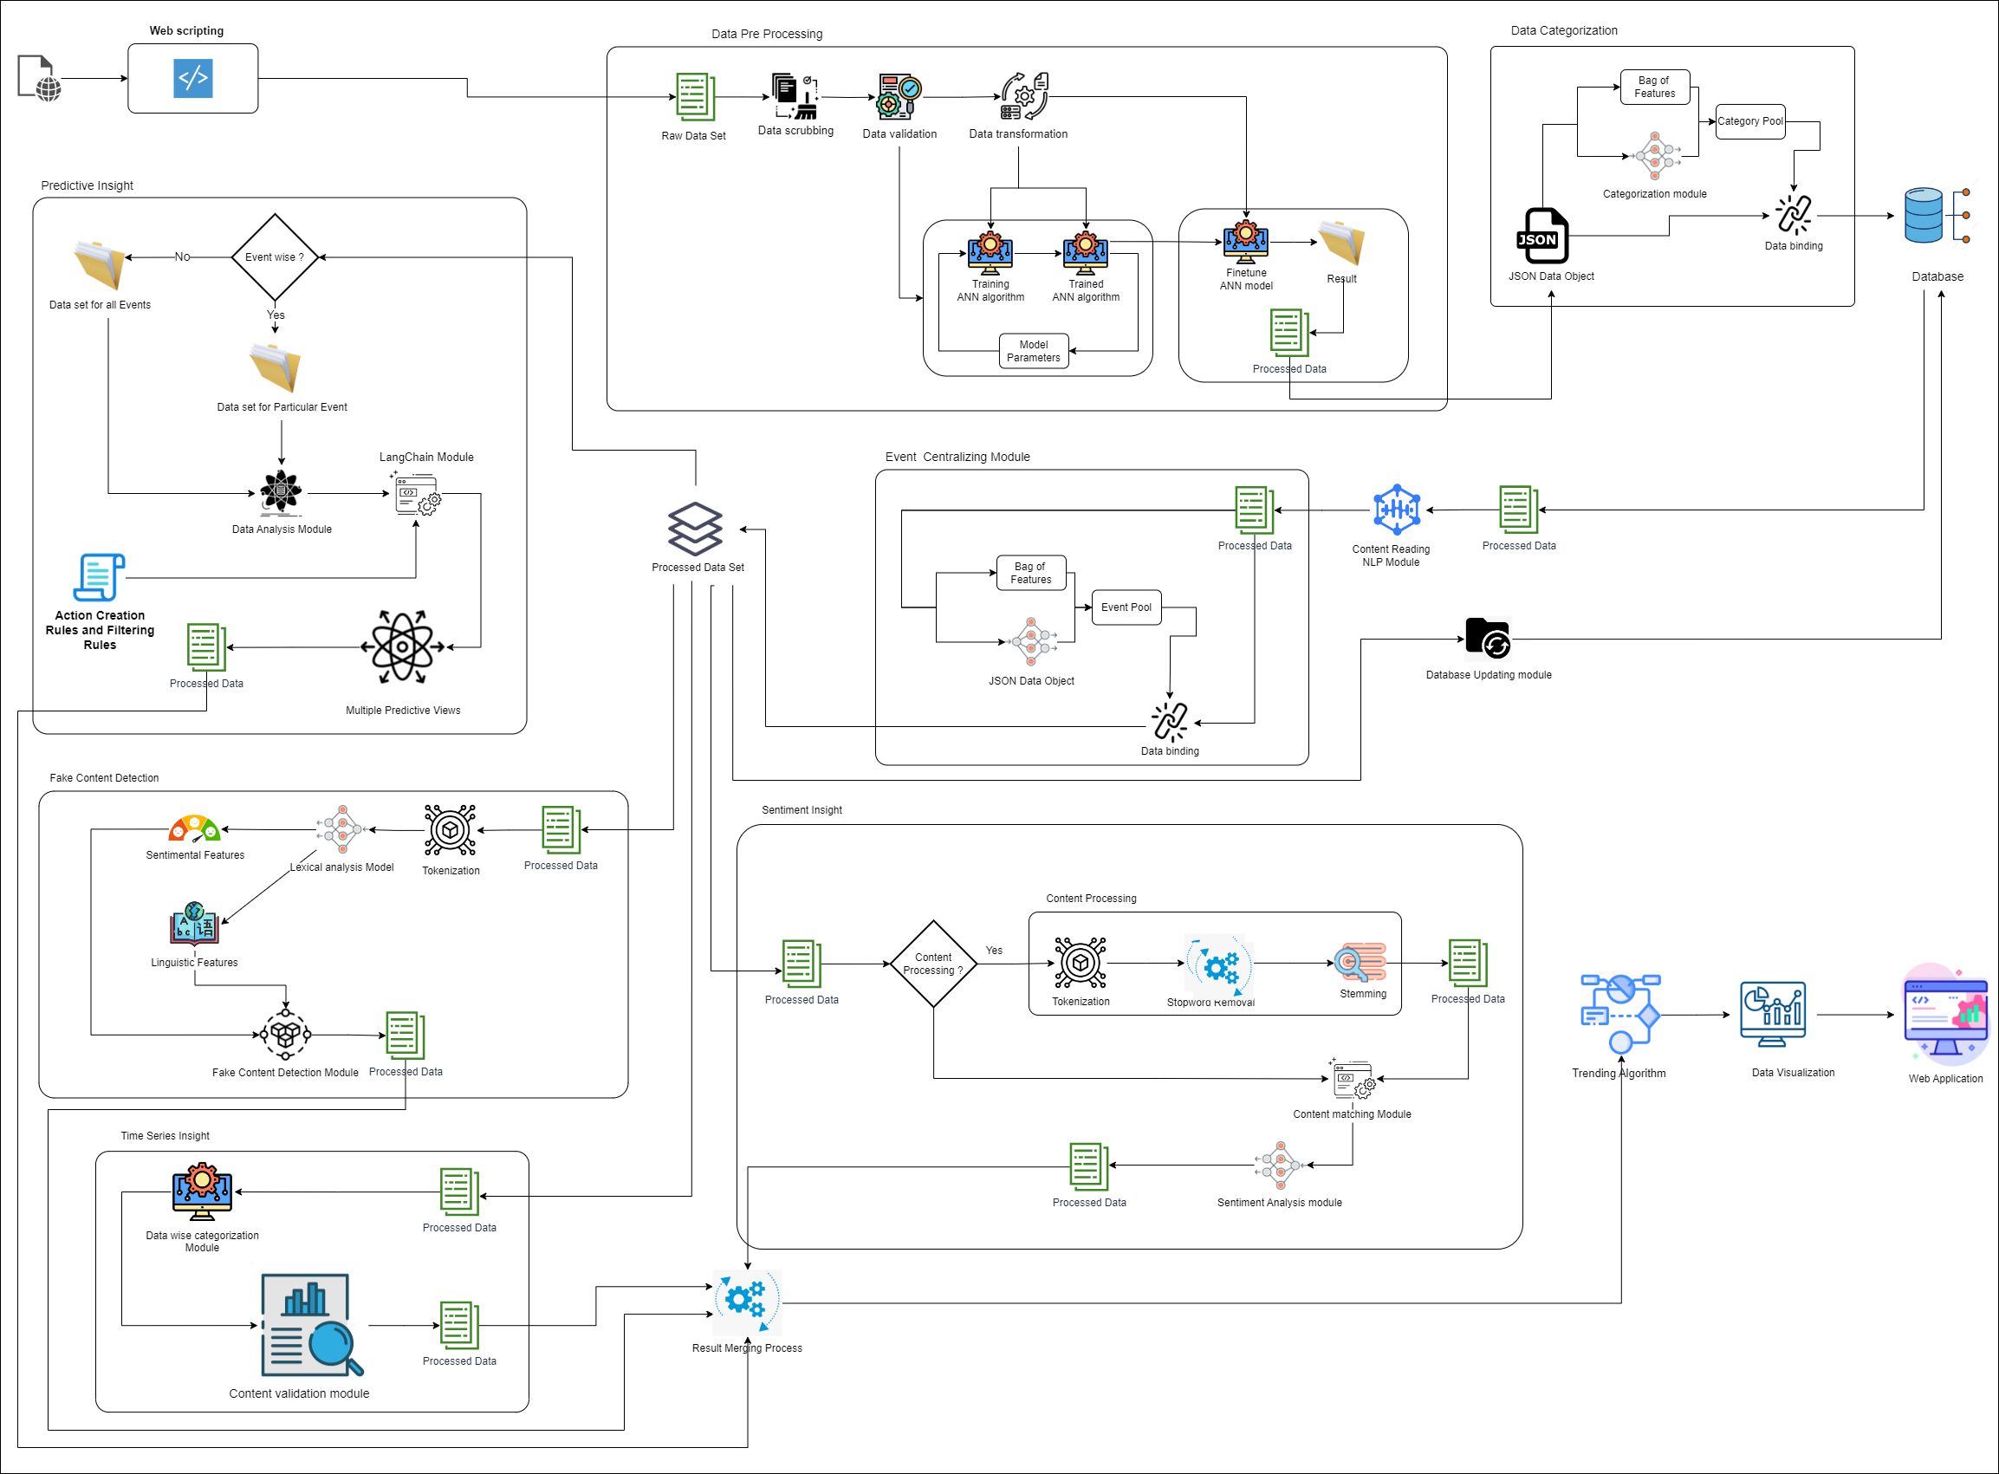
System Overall
Diagram

Slide 9
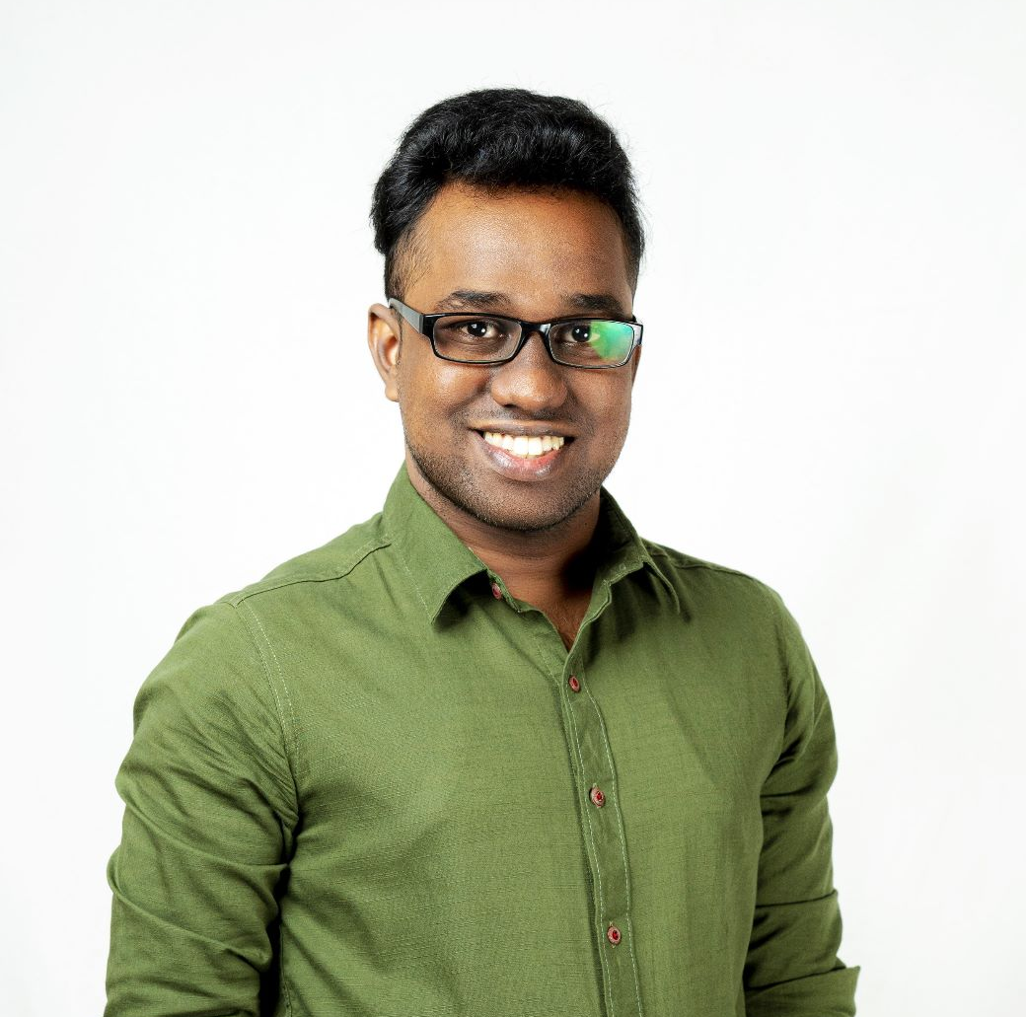

Classifying the categorizations and explanations of News.
IT20113704 | JAYAWARDHANA J.D.N.T
Bachelor of Science (Hons) in Information Technology
Specializing in Information Technology
IT20113704 | Jayawardhana J.D.N.T | 2023-24-043
7/31/2023

Slide 10
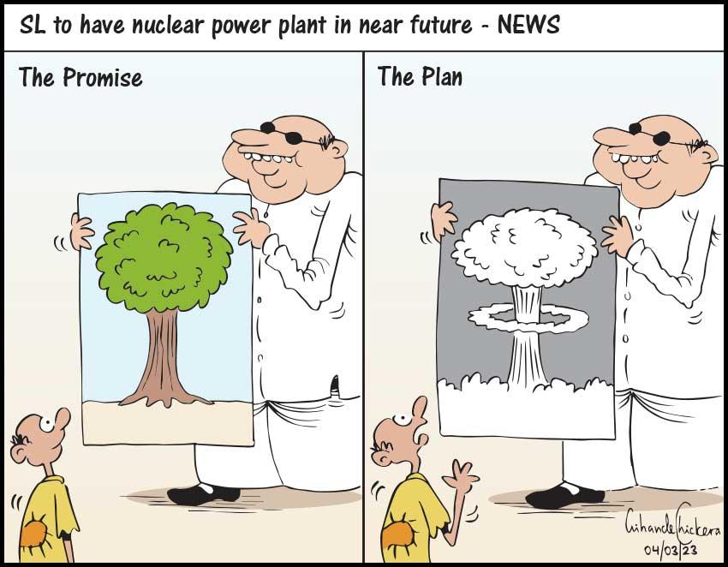
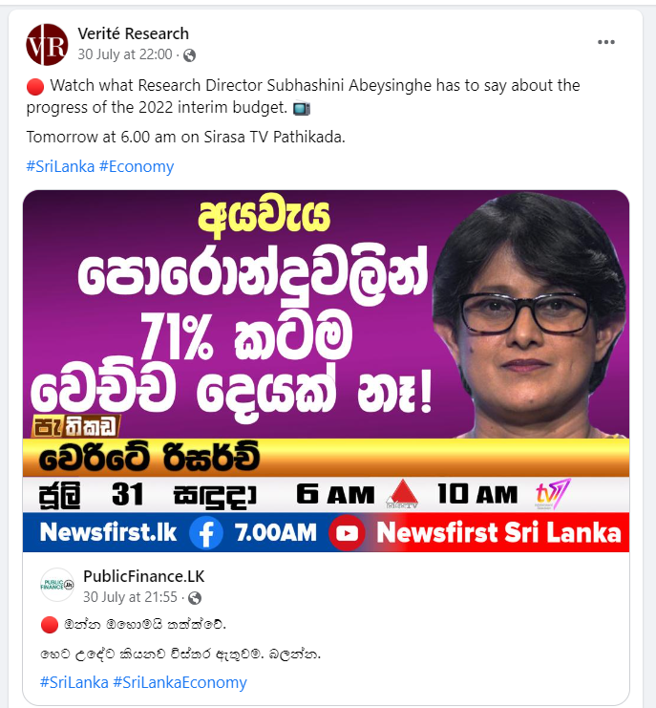

INTRODUCTION AND BACKGROUND
Regardless of the abundance of information available, individuals often tend to make judgments or predictions based on their personal educational, social, and other life experiences. Here, the focus is on empowering people to make informed decisions by illustrating the correlations between significant past events and potential future occurrences, all based on current events
IT20113704 | Jayawardhana J.D.N.T | 2023-24-043
7/31/2023

Slide 11
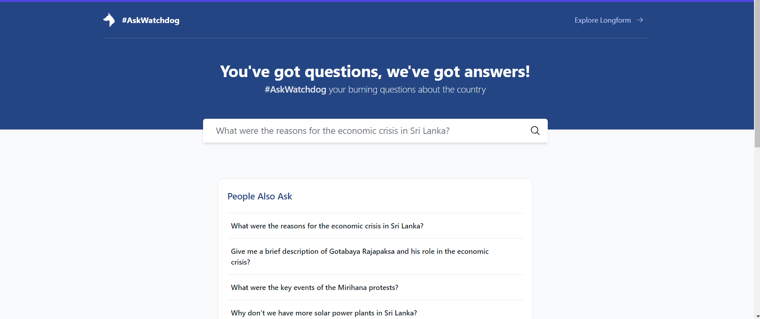
RESEARCH GAP
As an example, offering predictions regarding the probability of future occurrences, like environmental impacts, economic consequences, and societal shifts, arising from the MV-x-perl ship incident
IT20113704 | Jayawardhana J.D.N.T | 2023-24-043
7/31/2023

Slide 12
SPECIFIC OBJECTIVE
This platform provides an insight prediction based on various opinions obtained based on current events and historical events related to similar events.
Qualitative data analysis is done to provide a connection of an event that may happen in the future in relation to a certain event.
IT20113704 | Jayawardhana J.D.N.T | 2023-24-043
7/31/2023

Slide 13

SUB OBJECTIVES
Building a model to classifying the categorizations and explanations of content.
Building a model to analyze the sentiment of the Alternative views.
Building a model to analyze the changes in the sentiment of a content over time.
Building a model to detect the mis or dis information among the contents.

Slide 14
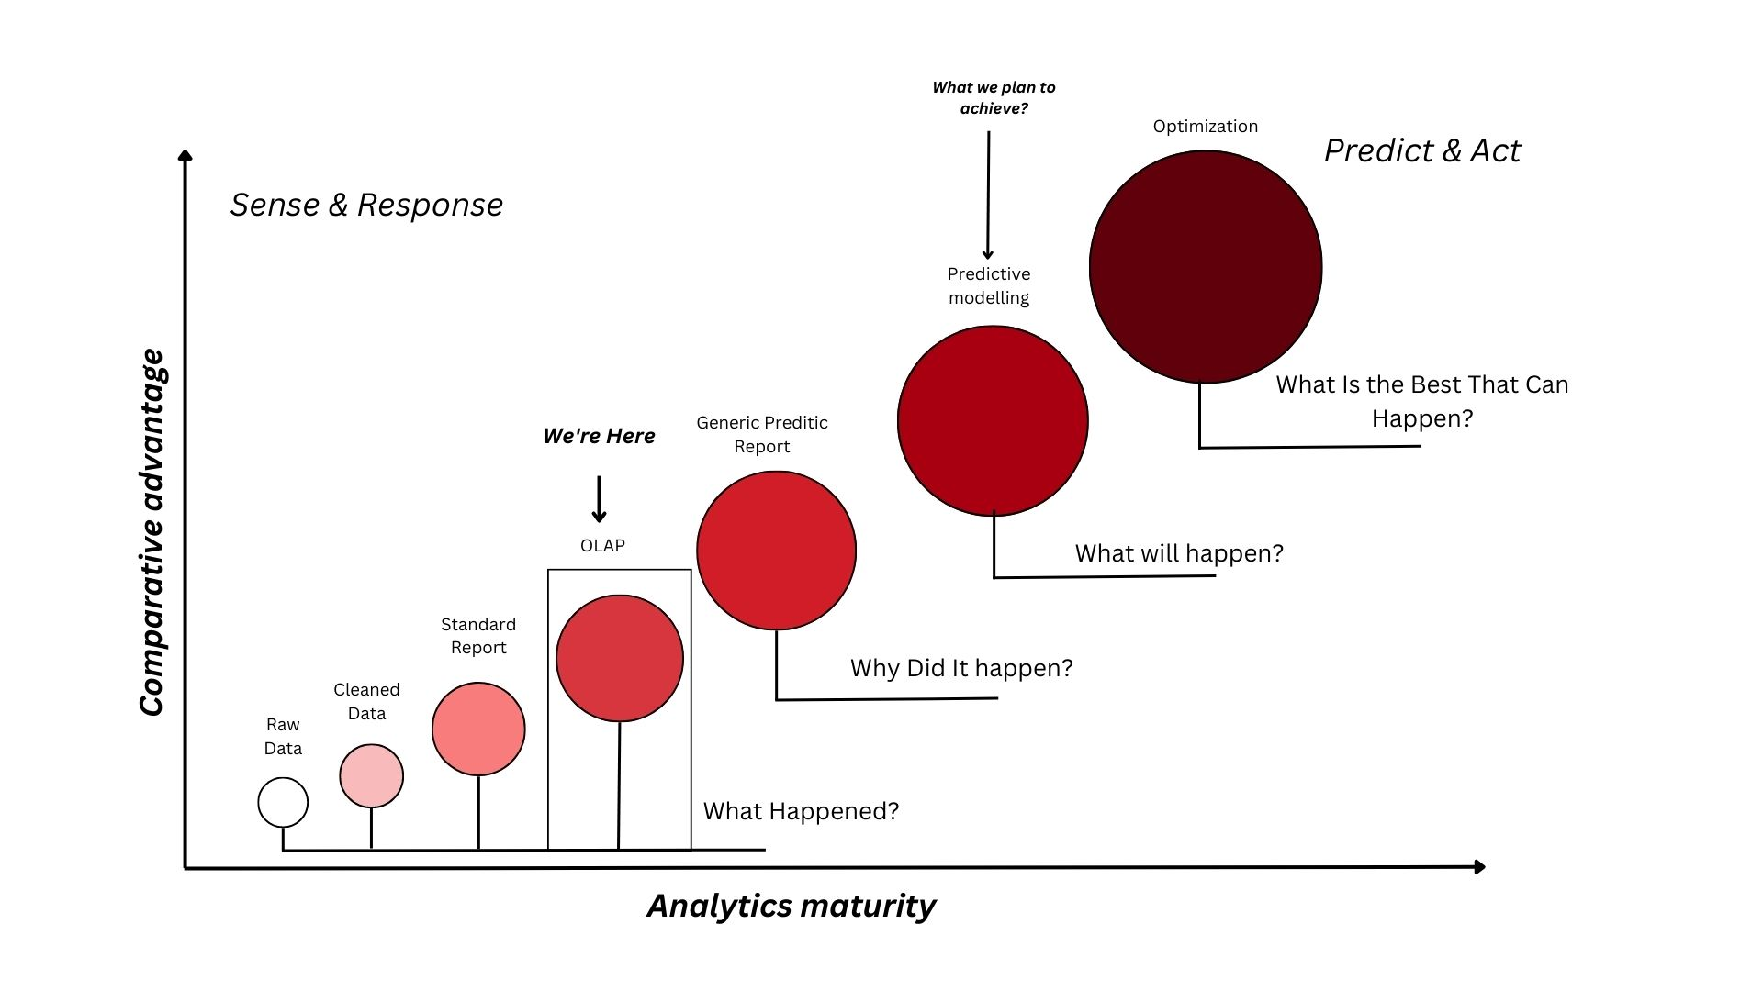
RESEARCH PROBLEM
Why did it happen?
What will happen?
What is the best that can happen?
IT20113704 | Jayawardhana J.D.N.T | 2023-24-043
7/31/2023

Slide 15
SUB OBJECTVES
Analyzing the content to understand the meaning of the content
Providing information on the likelihood of events and the capacity to find both obvious and covert incidences.
Simplifying a complex subject to facilitate better comprehension.
IT20113704 | Jayawardhana J.D.N.T | 2023-24-043
7/31/2023

Slide 16
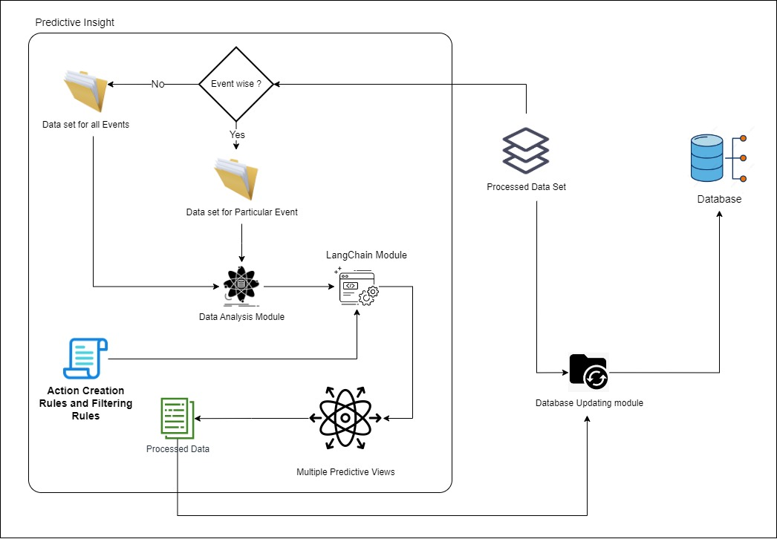
METHODOLOGY
IT20113704 | Jayawardhana J.D.N.T | 2023-24-043
7/31/2023

Slide 17






TOOLS AND TECHNOLOGY AND ALGORITHMS
Technologies
Natural Language Processing (NLP)
Generative AI
Predictive modeling
Tools
Visual Studio Code
Github
React Agent
Langchain
Angular
xAI
Python
Algorithms
Linear Regression
Logistic Regression
Linear Discriminant Analysis
IT20113704 | Jayawardhana J.D.N.T | 2023-24-043
7/31/2023

Slide 18
Accurately identify the information related to
a particular question
Less response time
High Process speed
High Capacity
FUNCTIONAL REQUIREMENTS
IT20113704 | Jayawardhana J.D.N.T | 2023-24-043
7/31/2023

Slide 19
Reliability
Realtime
Availability
Efficiency
Accuracy
Collaborate
Decision making
NON-FUNCTIONAL REQUIREMENTS
IT20113704 | Jayawardhana J.D.N.T | 2023-24-043
7/31/2023

Slide 20
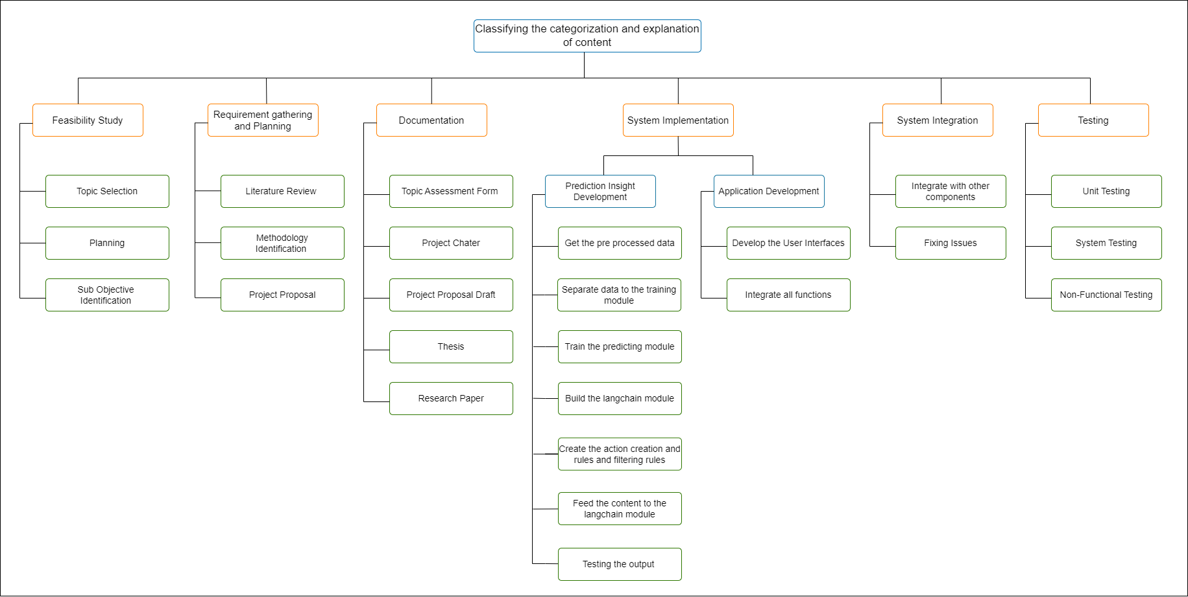
WORK BREAKDOWN STRUCTURE
IT20113704 | Jayawardhana J.D.N.T | 2023-24-043
7/31/2023

Slide 21
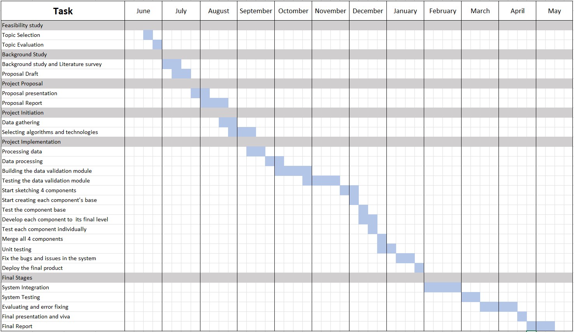
GANTT CHART
IT20113704 | Jayawardhana J.D.N.T | 2023-24-043
7/31/2023

Slide 22
REFERENCE
[1] D. R. Prabodanie, "The Island," 5 11 2021. [Online]. Available: https://island.lk/data-driven- decision-making-for-economic-prosperity-and-good-governance-part-i/.
[2] D. R. Prabodanie, "The Island," http://island.lk/, 6 11 2021. [Online]. Available: https://island.lk/data- driven-decision-making-for-economic-prosperity-and-good-governance-ii/.
[3] C. C. OFFICER, "CPA," https://cpalanka.org/, 26 04 2022. [Online]. Available: https://www.cpalanka.org/right-to-information-issues-and-challenges-of-policy-and-implementation/.
IT20113704 | Jayawardhana J.D.N.T | 2023-24-043
7/31/2023

Slide 23

Sentiment analysis for alternative views
IT20631260 | JAYATHILAKA S.A.D.R.P
Bachelor of Science (Hons) in Information Technology
Specializing in Software Engineering
IT20631260 | Jayathilaka S.A.D.R.P | 2023-24-043
7/31/2023

Slide 24
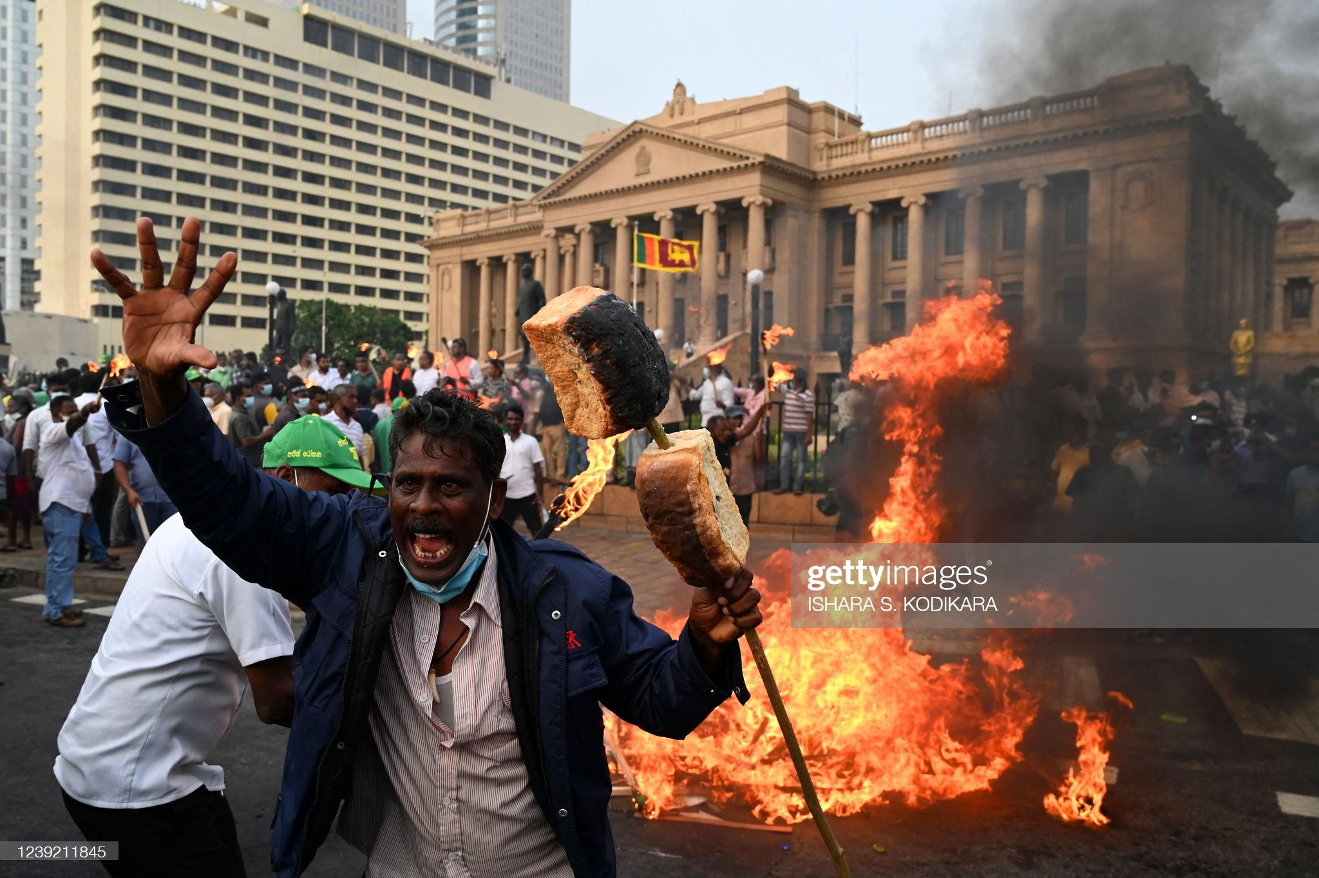
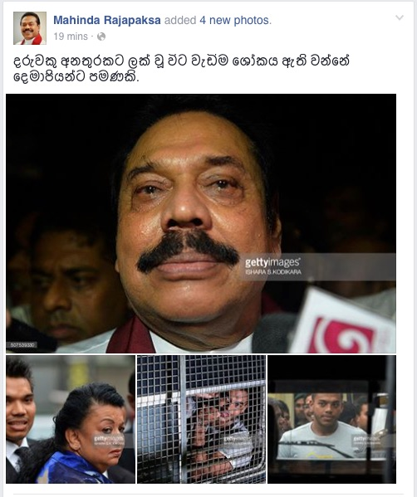
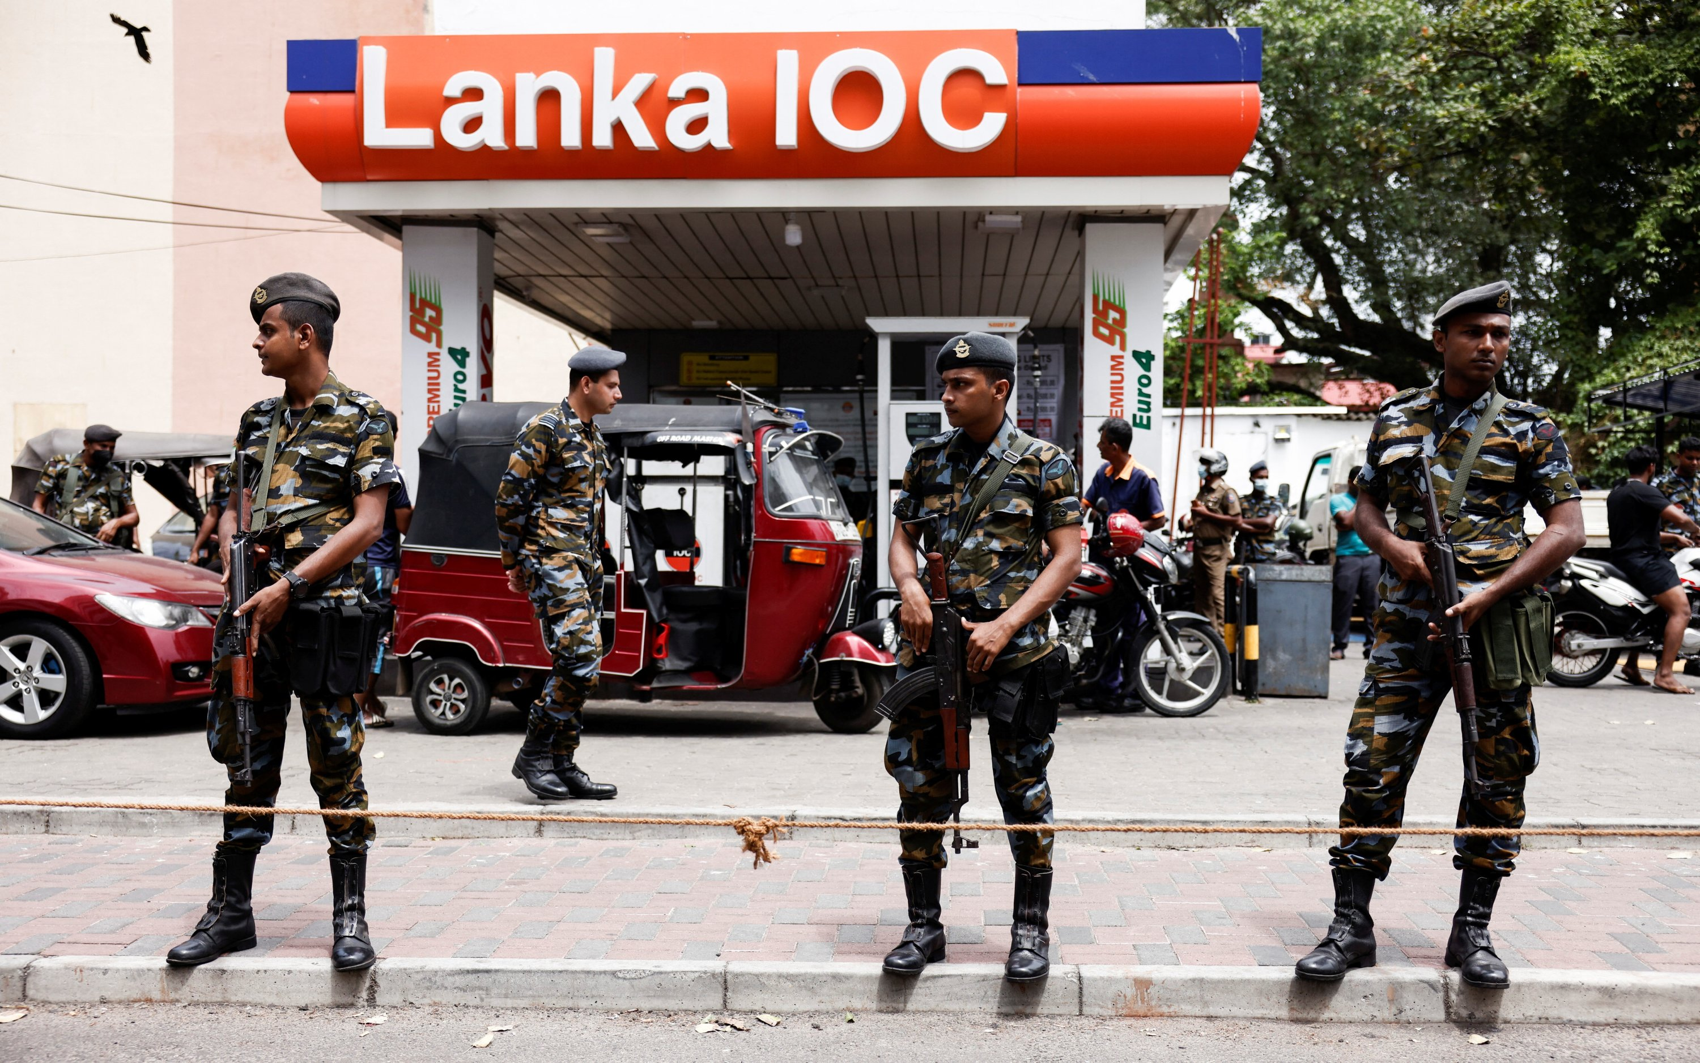
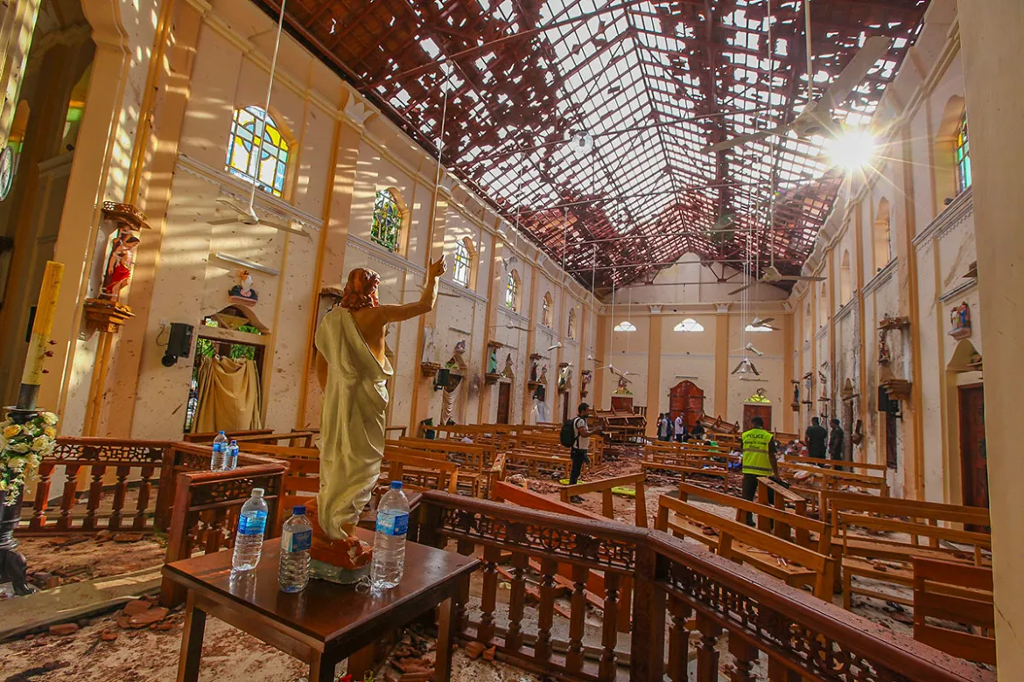
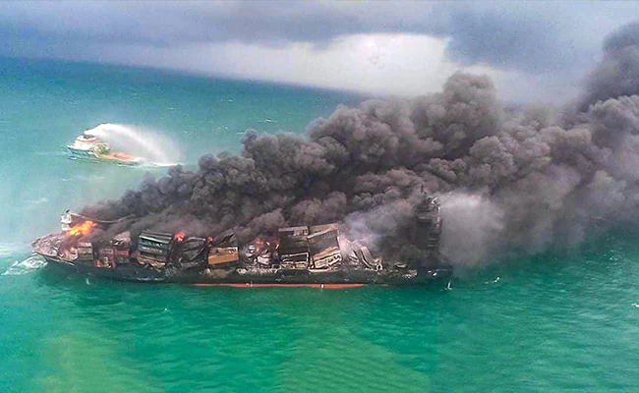
INTRODUCTION AND BACKGROUND
Different opinions are expressed regarding various trends and events happening in the society. With each of these events, different opinions appear in society. Setting up a platform where users can view all of them.
IT20631260 | Jayathilaka S.A.D.R.P | 2023-24-043
7/31/2023

Slide 25
RESEARCH GAP
Different opinions are expressed regarding various trends and events happening in the society. With each of these events, different opinions appear in society. Setting up a platform where users can view all of them
MV - X Press Peal With the fire of the ship, different opinions were expressed by different parties. That is, opinions from the public sector, From the company that owns the ship, environmental organizations, religious organizations, political parties, and the general public appeared on the Internet. The goal is to identify all of that
IT20631260 | Jayathilaka S.A.D.R.P | 2023-24-043
7/31/2023

Slide 26
RESEARCH PROBLEM
The accuracy of information in the media can be compromised due to the publisher's inherent biases and opinions, leading to challenges for users who seek reliable information.
IT20631260 | Jayathilaka S.A.D.R.P | 2023-24-043
7/31/2023

Slide 27
SPECIFIC OBJECTIVE
Can we always trust that published information is the most accurate?
Why is it important to consider different perspectives and views when seeking information?
Is it feasible to have comprehensive knowledge of all the information within the existing system?
IT20631260 | Jayathilaka S.A.D.R.P | 2023-24-043
7/31/2023

Slide 28
SUB OBJECTVES
Analyzing both positive and negative perspectives and demonstrating a potential practical implementation.
Establishing credibility and safeguarding users' information as a reliable platform.
Advocating the right to access information.
IT20631260 | Jayathilaka S.A.D.R.P | 2023-24-043
7/31/2023

Slide 29
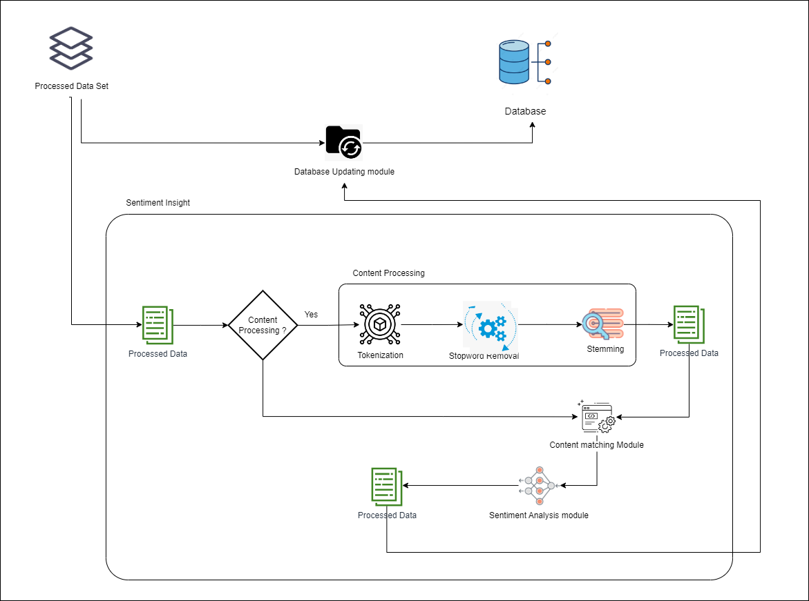
METHODOLOGY
IT20631260 | Jayathilaka S.A.D.R.P | 2023-24-043
7/31/2023

Slide 30





TOOLS AND TECHNOLOGY AND ALGORITHMS
Technologies
Natural Language Processing (NLP)
Web scripting
Content sentimental analysis
Tools
Visual Studio Code
Github
TensorFlow
PyTorch
FastText
Scikit-learn
Algorithms
Naive Bayes
Zhang and Shasha’s Algorithm
Treedist
iSA (integrated sentiment analysis)
iSAX
IT20631260 | Jayathilaka S.A.D.R.P | 2023-24-043
7/31/2023

Slide 31
FUNCTIONAL REQUIREMENTS
Accurately identify the information related to a particular question
Less response time
High Process speed
High Capacity
IT20631260 | Jayathilaka S.A.D.R.P | 2023-24-043
7/31/2023

Slide 32
NON-FUNCTIONAL REQUIREMENTS
Reliability
Realtime
Availability
Efficiency
Accuracy
Collaborate
Decision making
IT20631260 | Jayathilaka S.A.D.R.P | 2023-24-043
7/31/2023

Slide 33
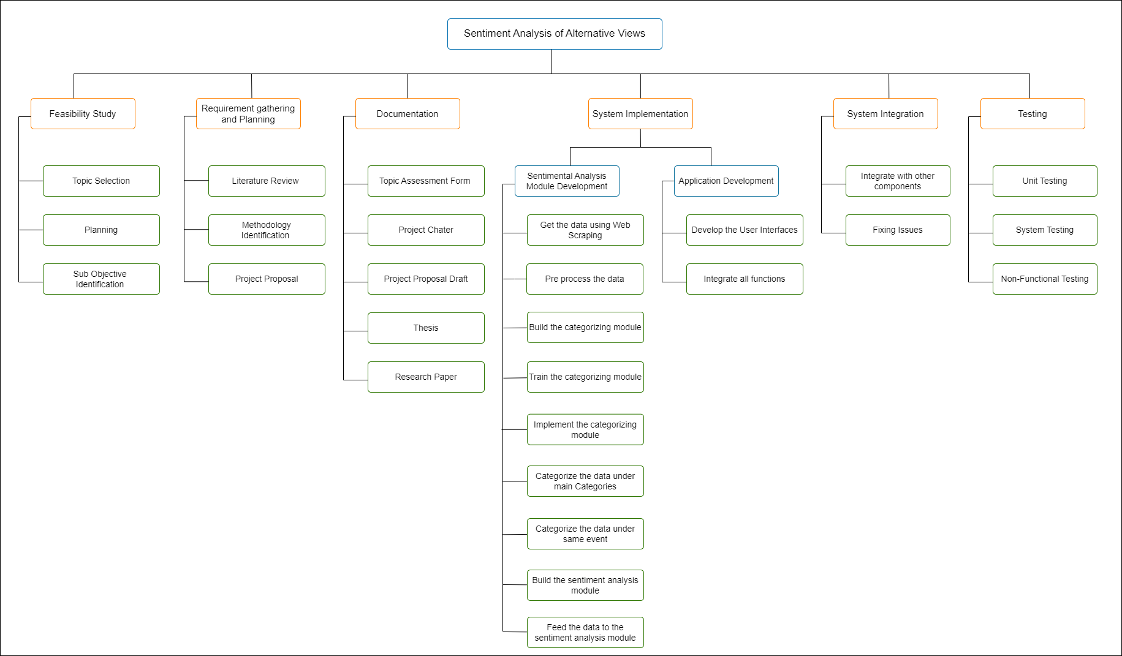
WORK BREAKDOWN STRUCTURE
IT20631260 | Jayathilaka S.A.D.R.P | 2023-24-043
7/31/2023

Slide 34
GANTT CHART
IT20631260 | Jayathilaka S.A.D.R.P | 2023-24-043
7/31/2023

Slide 35
REFERENCE
W. Medhat, "Sentiment analysis algorithms and applications: A survey," sciencedirect, vol. 5, no. 4, pp. 1019-1113, 2014.
L. Zhang, "Deep learning for sentiment analysis," 30 March 2018. [Online]. Available: https://wires.onlinelibrary.wiley.com/doi/abs/10.1002/widm.1253. [Accessed 10 July 2023].
D. Tang, "Deep learning for sentiment analysis: successful approaches and future challenges," 23 October 2015. [Online]. Available: https://wires.onlinelibrary.wiley.com/doi/abs/10.1002/widm.1171. [Accessed 12 July 2023].
K. Chakraborty, "Sentiment Analysis of COVID-19 tweets by Deep Learning Classifiers—A study to show how popularity is affecting accuracy in social media," 28 September 2020. [Online]. Available: https://www.sciencedirect.com/science/article/pii/S156849462030692X. [Accessed 11 July 2023].
D. Li, "Text sentiment analysis based on long short-term memory," in IEEE, Wuhan, China, 2016.
IT20631260 | Jayathilaka S.A.D.R.P | 2023-24-043
7/31/2023

Slide 36

Time Series Analysis of the Alternative contents.
IT20633240 | LAKSHAN W.R.S.M.M
Bachelor of Science (Hons) in Information Technology
Specializing in Information Technology
IT20633240 | Lakshan W.R.S.M.M | 2023-24-043
7/31/2023

Slide 37
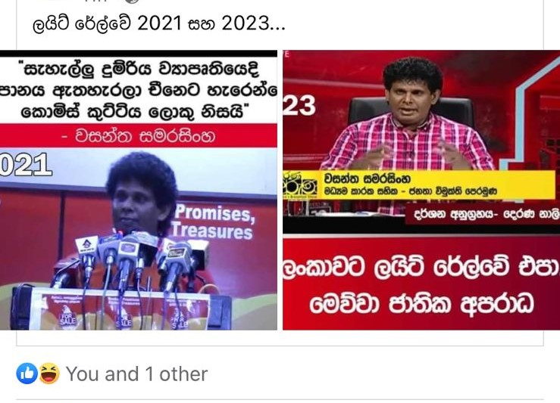

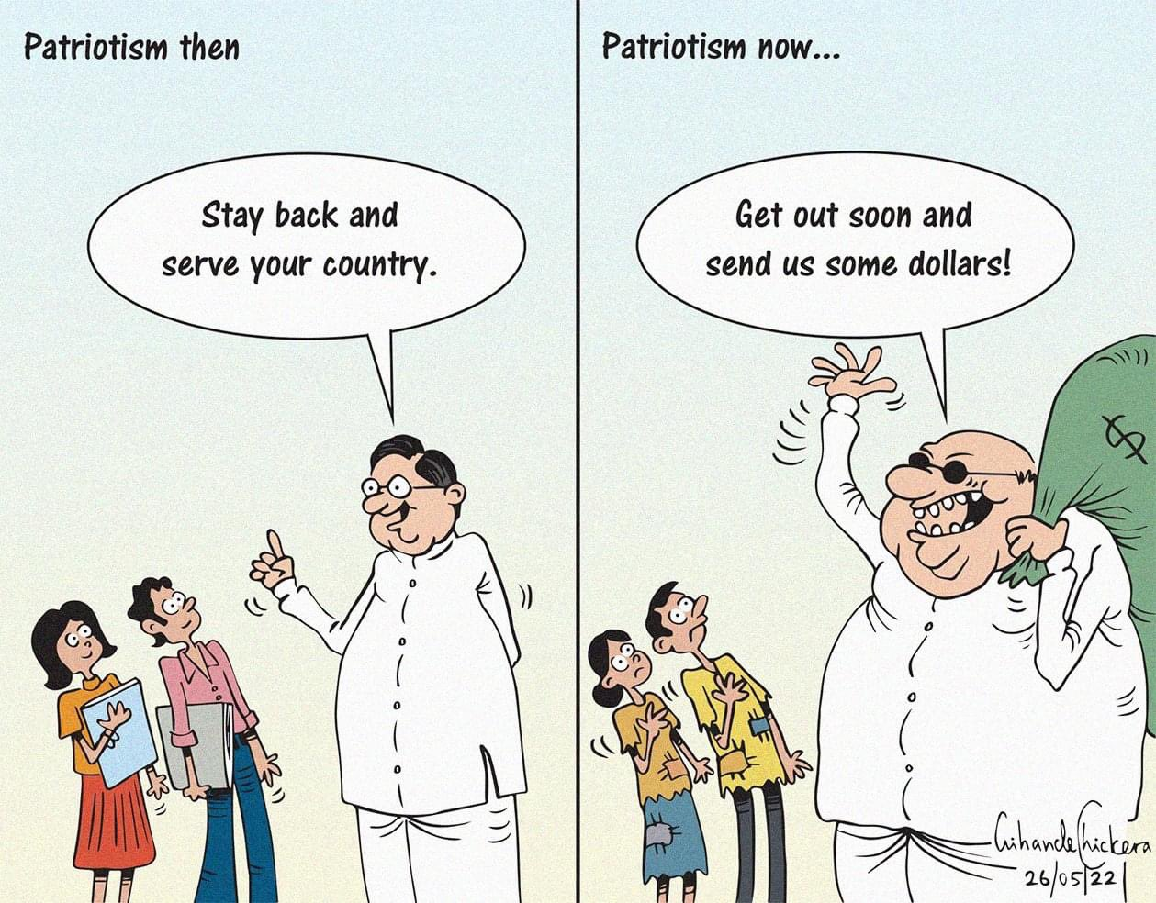
INTRODUCTION AND BACKGROUND
Over time, there are changes in the opinions related to the events. It is possible that one day in the future there will be an opinion that is completely different from the opinion of the present. The aim is to update all those opinions periodically.
EX:- Regarding the incident of the MV - X - Press Pearl ship, the news that is completely different from the opinion that was in the year 2021 is currently being published in the political authority and society.
IT20633240 | Lakshan W.R.S.M.M | 2023-24-043
7/31/2023

Slide 38
RESEARCH GAP
There is no timely update on events that may affect society. Although they are important to society, they are lost due to forgetfulness.
IT20633240 | Lakshan W.R.S.M.M | 2023-24-043
7/31/2023

Slide 39
RESEARCH PROBLEM
How do users get all the real-time updates related to an event?
Ability to recognize changes in current events over time
IT20633240 | Lakshan W.R.S.M.M | 2023-24-043
7/31/2023

Slide 40
SPECIFIC OBJECTIVE
Developing a model to display how sentiment change occurs in alternative views
IT20633240 | Lakshan W.R.S.M.M | 2023-24-043
7/31/2023

Slide 41
SUB OBJECTVES
Event-time updates related to the entire event in a single model
Providing accurate information to users by creating a model that can be trusted
Minimize the chance of missing information
IT20633240 | Lakshan W.R.S.M.M | 2023-24-043
7/31/2023

Slide 42
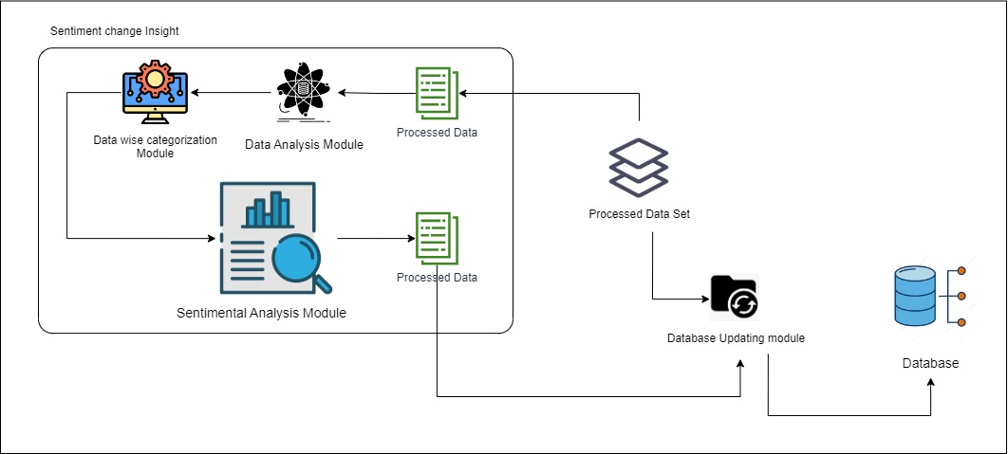
METHODOLOGY
IT20633240 | Lakshan W.R.S.M.M | 2023-24-043
7/31/2023

Slide 43
TOOLS AND TECHNOLOGY AND ALGORITHMS
Technologies
Natural Language Processing (NLP)
Time - based content analysis
Tools
Visual Studio Code
GitHub
Angular
Python
IT20633240 | Lakshan W.R.S.M.M | 2023-24-043
7/31/2023

Slide 44
Accurately identify the information related to a particular question
Less response time
High Process speed
High Capacity
FUNCTIONAL REQUIREMENTS
IT20633240 | Lakshan W.R.S.M.M | 2023-24-043
7/31/2023

Slide 45
Reliability
Realtime
Availability
Efficiency
Accuracy
Collaborate
Decision making
NON-FUNCTIONAL REQUIREMENTS
IT20633240 | Lakshan W.R.S.M.M | 2023-24-043
7/31/2023

Slide 46
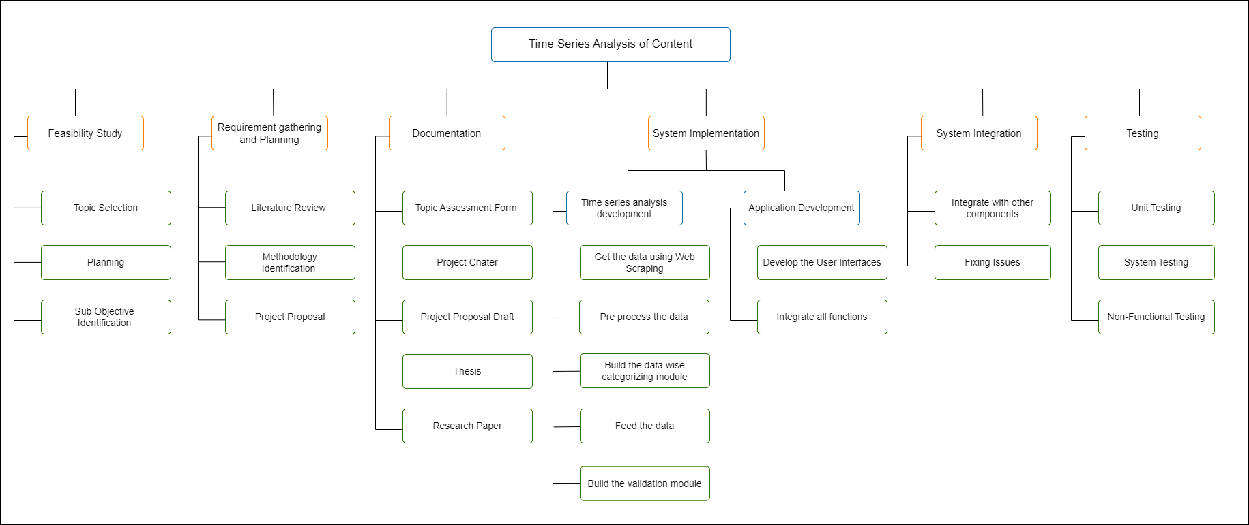
WORK BREAKDOWN STRUCTURE
IT20633240 | Lakshan W.R.S.M.M | 2023-24-043
7/31/2023

Slide 47
GANTT CHART
IT20633240 | Lakshan W.R.S.M.M | 2023-24-043
7/31/2023

Slide 48
REFERENCE
L. Zhang, "Deep learning for sentiment analysis," 30 March 2018. [Online]. Available: https://wires.onlinelibrary.wiley.com/doi/abs/10.1002/widm.1253. [Accessed 10 July 2023].
D. Tang, "Deep learning for sentiment analysis: successful approaches and future challenges," 23 October 2015. [Online]. Available: https://wires.onlinelibrary.wiley.com/doi/abs/10.1002/widm.1171. [Accessed 12 July 2023].
K. Chakraborty, "Sentiment Analysis of COVID-19 tweets by Deep Learning Classifiers—A study to show how popularity is affecting accuracy in social media," 28 September 2020. [Online]. Available: https://www.sciencedirect.com/science/article/pii/S156849462030692X. [Accessed 11 July 2023].
D. Li, "Text sentiment analysis based on long short-term memory," in IEEE, Wuhan, China, 2016.
IT20633240 | Lakshan W.R.S.M.M | 2023-24-043
7/31/2023

Slide 49

Detecting the Mis / Disinformation among the contents
IT20623722 | KUMARA S.K
Bachelor of Science (Hons) in Information Technology
Specializing in Cyber Security
IT20623722 | Kumara S.K| 2023-24-043
7/31/2023

Slide 50
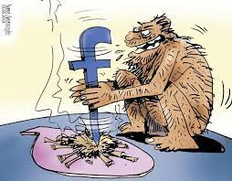
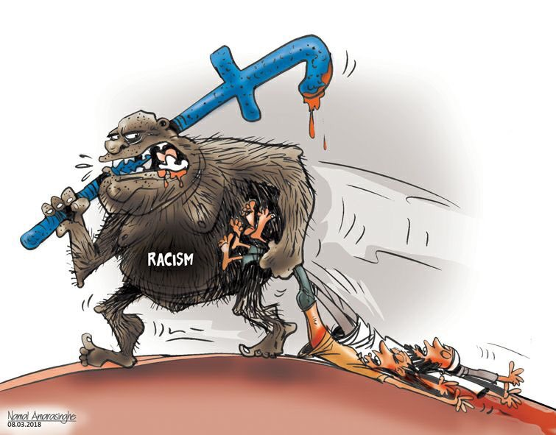
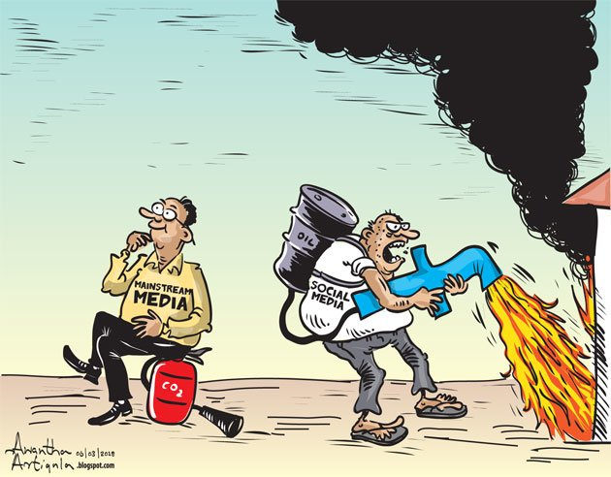
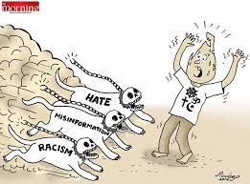
INTRODUCTION AND BACKGROUND
Nowadays, there are more incidents that create news and they are reported by the media in different ways. Some of these are fake news. In a country like Sri Lanka, the majority of the society is a group of people who make decisions based on emotions, so there are many problems due to the socialization of fake news.
IT20623722 | Kumara S.K| 2023-24-043
7/31/2023

Slide 51
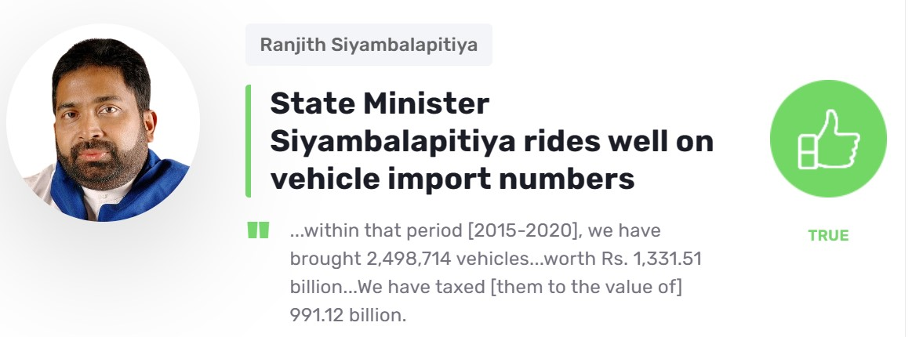
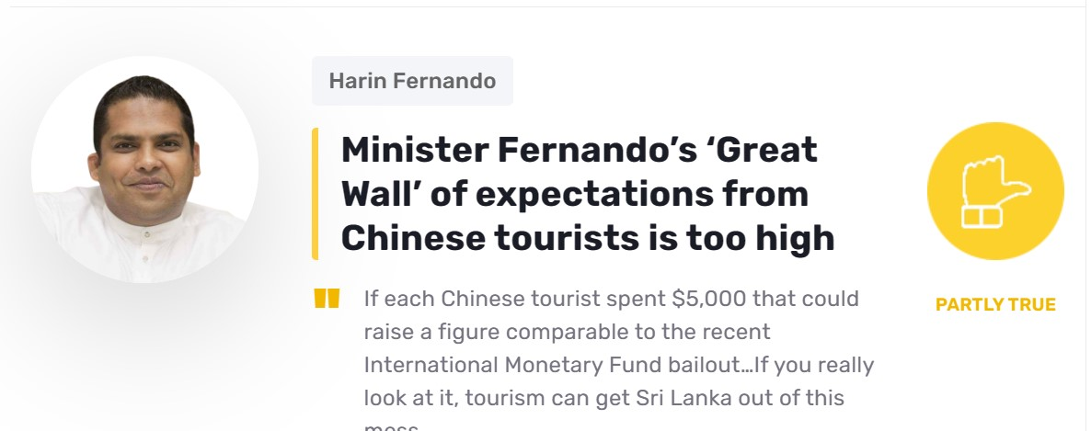
RESEARCH GAP
In Sri Lanka there is a shortcoming of an automated system for identifying fake news. The process is done manually through the existing systems.
IT20623722 | Kumara S.K| 2023-24-043
7/31/2023

Slide 52
RESEARCH PROBLEM
In a country like Sri Lanka, due to lack of media regulation and weaknesses in law enforcement, information is distributed to digital media without limit. Along with this, there is a large amount of fake news, which suppresses the true information
IT20623722 | Kumara S.K| 2023-24-043
7/31/2023

Slide 53
SPECIFIC OBJECTIVE
The goal of this component is to filter the information obtained from alternative views and identify fake news.
IT20623722 | Kumara S.K| 2023-24-043
7/31/2023

Slide 54
SUB OBJECTVES
Knowing the accuracy of all news and information related to an event
Verification of all information through an automated system
IT20623722 | Kumara S.K| 2023-24-043
7/31/2023

Slide 55
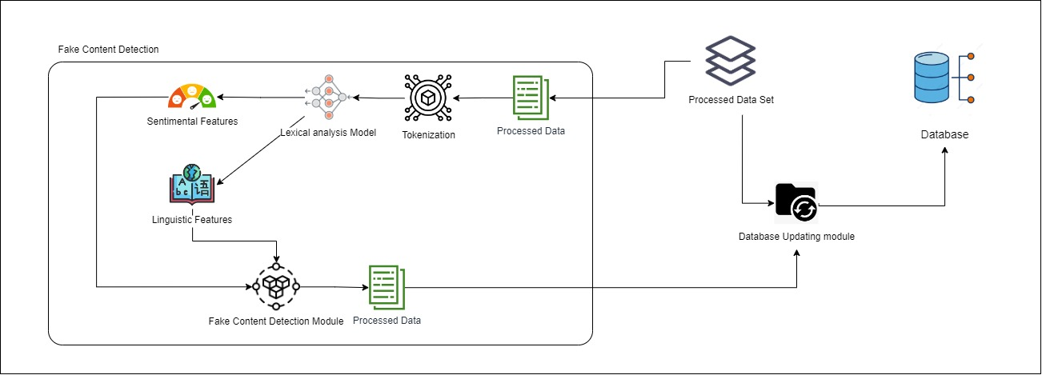
METHODOLOGY
IT20623722 | Kumara S.K| 2023-24-043
7/31/2023

Slide 56


TOOLS AND TECHNOLOGY AND ALGORITHMS
Technologies
Natural Language Processing (NLP)
Lexical Analysis Model
Tools
Visual Studio Code
Github
React
Angular
Python
Algorithms
ANN
RNN
CNN
LSTM
IT20623722 | Kumara S.K| 2023-24-043
7/31/2023

Slide 57
FUNCTIONAL REQUIREMENTS
Accurately identify the information related to a particular question
Less response time
High Process speed
High Capacity
IT20623722 | Kumara S.K| 2023-24-043
7/31/2023

Slide 58
NON-FUNCTIONAL REQUIREMENTS
Reliability
Realtime
Availability
Efficiency
Accuracy
Collaborate
IT20623722 | Kumara S.K| 2023-24-043
7/31/2023

Slide 59

WORK BREAKDOWN STRUCTURE
IT20623722 | Kumara S.K| 2023-24-043
7/31/2023

Slide 60
GANTT CHART
IT20623722 | Kumara S.K| 2023-24-043
7/31/2023

Slide 61
REFERENCE
L. Zhang, "Deep learning for sentiment analysis," 30 March 2018. [Online]. Available: https://wires.onlinelibrary.wiley.com/doi/abs/10.1002/widm.1253. [Accessed 10 July 2023].
D. Tang, "Deep learning for sentiment analysis: successful approaches and future challenges," 23 October 2015. [Online]. Available: https://wires.onlinelibrary.wiley.com/doi/abs/10.1002/widm.1171. [Accessed 12 July 2023].
K. Chakraborty, "Sentiment Analysis of COVID-19 tweets by Deep Learning Classifiers—A study to show how popularity is affecting accuracy in social media," 28 September 2020. [Online]. Available: https://www.sciencedirect.com/science/article/pii/S156849462030692X. [Accessed 11 July 2023].
IT20623722 | Kumara S.K| 2023-24-043
7/31/2023

Slide 62
Budget
Description | Amount (USD) | Amount (LKR)
Travelling cost |  | 12000
Deployment cost |  | 16073 / month
Database cost |  | 22 / GB / month
Language models | $0.06 / 1K tokens
Subscription cost | $100/Year | 31912.92/Year

Slide 63
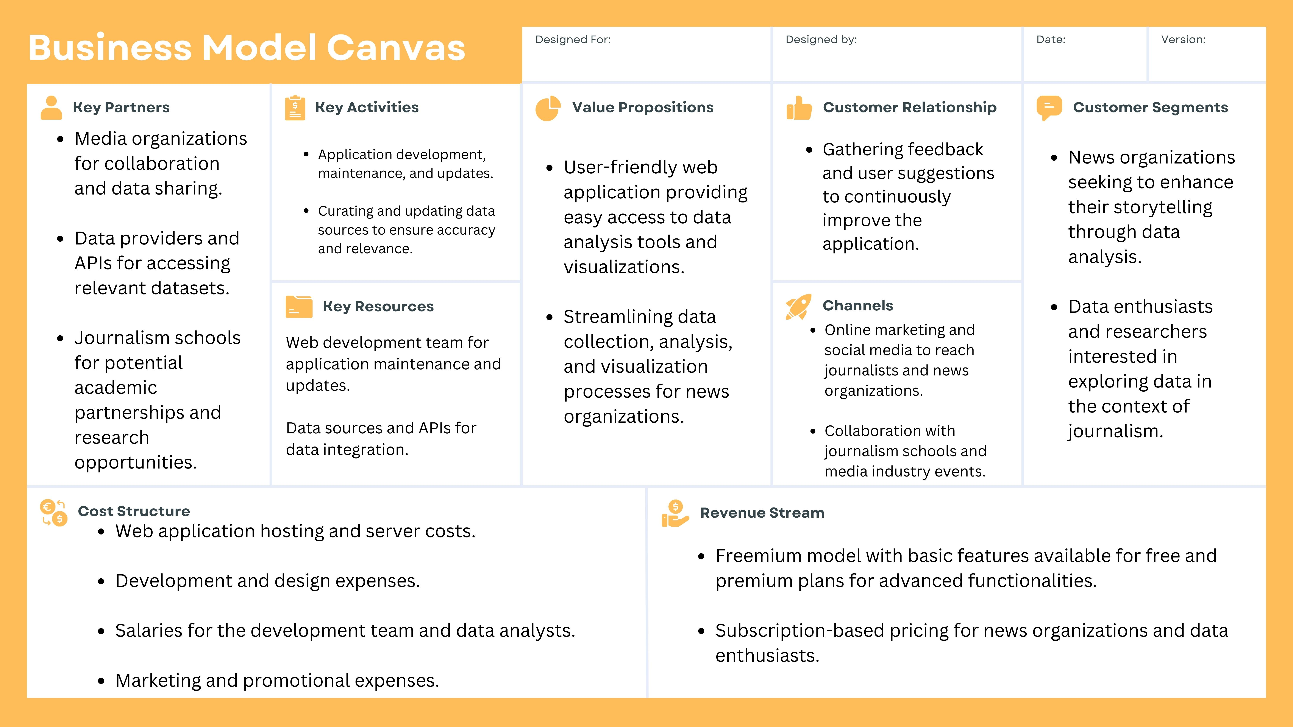
Business Model Canvas

